Slide 1
BIRD STRIKES ANALYSIS REPORT 2000-2011
AVASH KUMAR PANDA

Slide 2
CONTENTS
Introduction
Project Overview
Major Metrics
Dashboard
Report Analysis

Slide 3
INTRODUCTION
A bird strike is strictly defined as a collision between a bird and an aircraft during any phase of flight.

Slide 4
PROJECT OVERVIEW
This project includes an illustrative analysis on Bird Strikes between the years 2000 and 2011, and analysis attributes like Bird Strike occurrences, costs, and impacts across airlines, airports, and flight phases for aviation safety insights.

Slide 5
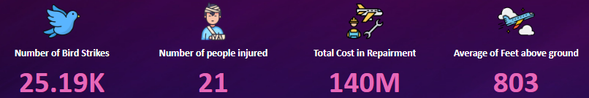
MAJOR METRICS

Slide 6
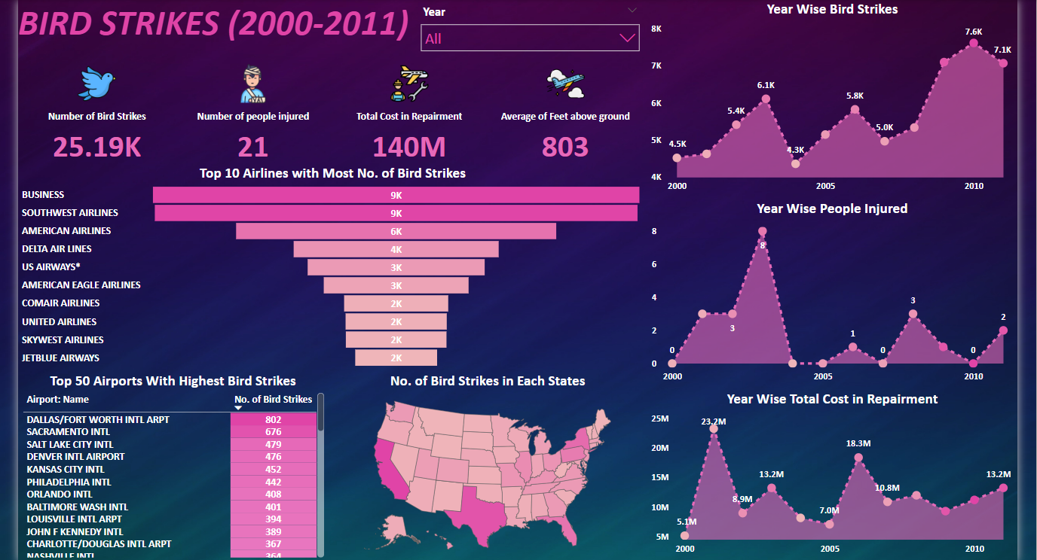
Dashboard 1

Slide 7
Report Analysis
The total number of bird strikes is over 25,000 in the span of 11 years, resulting in a repair cost of 140 million dollars.
The number of bird strikes continued to increase yearly from 2000 to 2011.
The highest number of bird strikes, 7604, occurred in 2010.
Airlines such as Business, Southwest Airlines, and American Airlines are more involved in bird strikes than other airlines.
DALLAS/FORT WORTH INTL AIRPORT has the highest number of bird strikes among all airports, with 802 strikes, followed by SACRAMENTO INTL with 676 strikes.
The state of California experienced the most bird strikes in the USA, with 6998 strikes, followed by Texas with 5983.
A total of 21 people were injured due to bird strikes from 2000 to 2011.
The highest number of injuries 8, occurred in 2003 due to bird strikes.
The average altitude at which most of the strikes occurred is 803 feet above the ground.

Slide 8
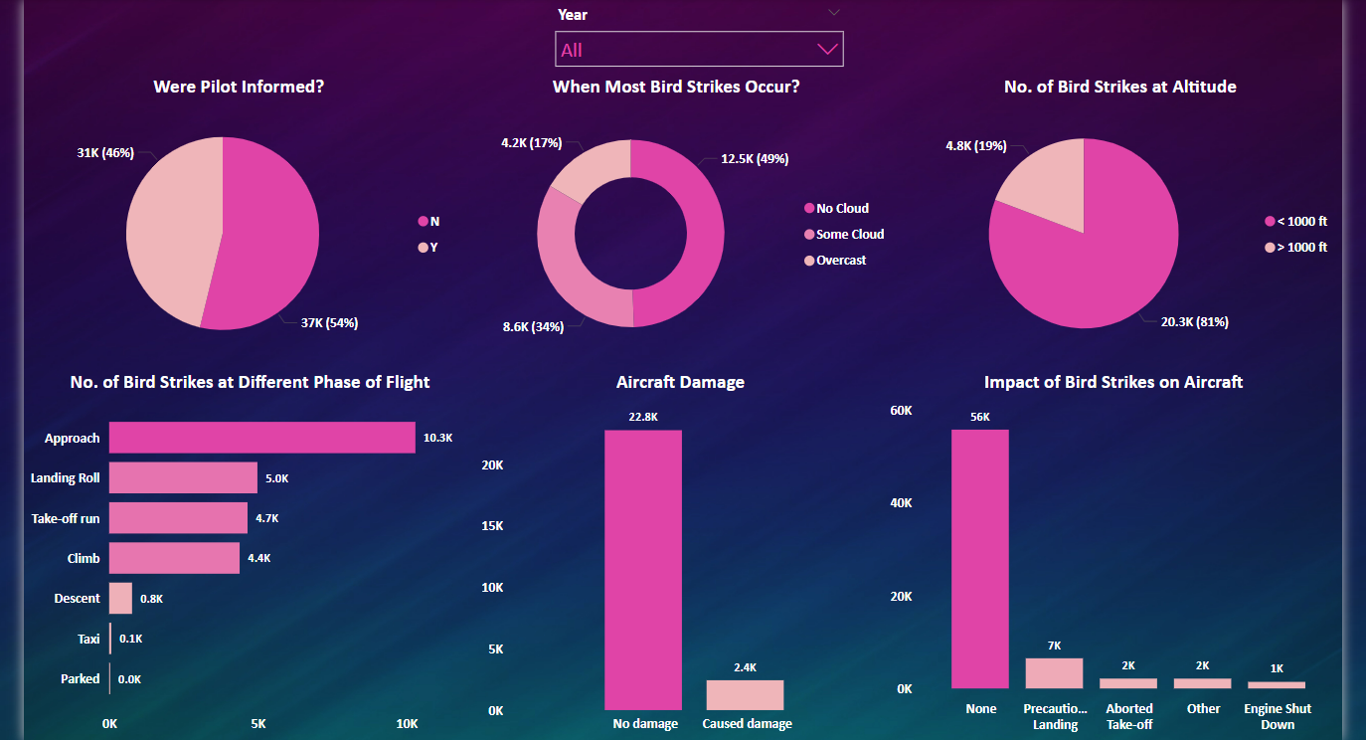
Dashboard 2

Slide 9
Report Analysis
Out of 25,194 flights involved in a bird strike incident, 22,764 received no damage, while 2430 received small to large scale damages.
Rain, fog, or snow has little to no relation to bird strikes, and in most cases when strikes occurred, the weather was fine.
In 54% of cases, pilots were not informed or were unaware of the possible bird strikes, whereas in 46% of cases they were informed prior to the strikes.
81% of the planes were flying at an altitude of less than 1,000 feet when the strikes occurred.
A high number of strikes occurred when the plane was approaching the runway, followed by landing roll and take-off run.
Most bird strikes result in no damage to the plane or the flight schedule.

Slide 10
THANK YOU

